Slide 1
welcome
October 13, 2024

Slide 2
Sunday

Slide 4
SERVING TODAY
Hosts: Gary & Bea Abbas
Liturgist: Marianne Doonan
Organist: Tom Luther
Kitchen: Janalee Keppy
TV Screens: CJ Albertson

Slide 5
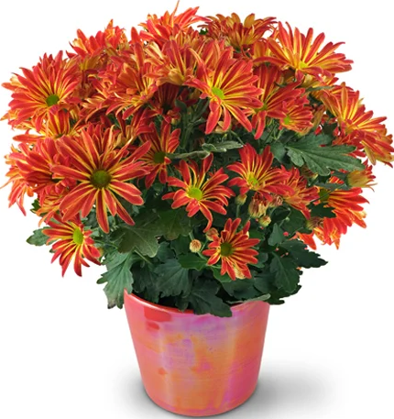
ALTAR
Today’s
FLOWERS
are from
Mike & Jan Wright

Slide 6
Today’s
VIDEO PRELUDE
“I Am An Offering”
Written by Dwight Liles / Performed by Chris Christian

Slide 7
Today’s Hymns
#354 “I Surrender All”
#398 “Jesus Calls Us”

Slide 8
COMING EVENTS
TODAY!-Last Sign-Up for “White Xmas”
TUES – Bible Study @ 10am
WED – Yoga @ 9am
– Assemble Ingathering (9am-?)
– Diabetes Workshop @6pm

Slide 9
OCT 20th HELPERS
Hosts: Ben & Karen Apple
Liturgist: Ryan Riewerts
Pianist: Cj Albertson
Kitchen: Rheta Allen
TV Screens: Stacy Muhs

Slide 10
45th annual
Ingathering
See samples & instructions on the Gathering Area table.

Slide 11
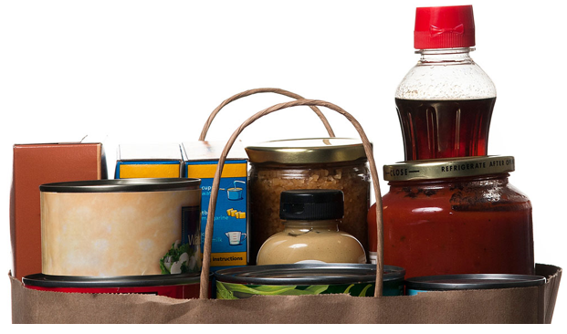
OCTOBER at the
FOOD PANTRY
*Instant Boxed Potatoes
*Gravy *Granola Bars

Slide 12
YOGA is back!
YOGA is back!
Come join us
Wednesday mornings
9am in the sanctuary

Slide 13
HURRICANES HELENE
and MILTON

Slide 14
“The MISSION of the
Eldridge United Methodist Church
is to be a community of loving disciples who proclaim and live love of God and neighbor.”

Slide 15
Make your Reservation
TODAY
Last day to Sign Up
in the
Gathering Area!

Slide 16
www.eldridgeumc.org

