Slide 3
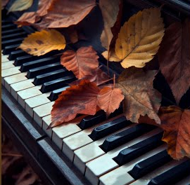
Prelude
Organist:
Tom Luther

Slide 4
Call to Worship
(responsive)

Slide 5
Liturgist:
We gather to listen to
the voice of Jesus say,
“Come, follow me!”

Slide 6
But will you follow when Jesus also calls you to release the hold wealth has on you?

Slide 7
People:
We want to follow Jesus anywhere he leads,
& we can with God’s help.

Slide 8
Liturgist:
We gather to remember all that God has taught us through scripture, tradition, reason, and experience.

Slide 9
But what about when
we have to put what
we know into action?

Slide 10
People:
We want to put our
faith into action
& we can with God’s help.

Slide 11
Liturgist:
We gather to live into God’s economy of abundance, recognizing the riches of the. . .

Slide 12
. . . prayers, presence,
gifts, service,
and witness
that surround us.

Slide 13
But what about when
the world tempts us
back into scarcity?

Slide 14
People:
We want to turn away from scarcity and
choose God’s abundance
& we can with God’s help.

Slide 15
Liturgist:
We gather to shine
as a beacon of a
new way of living . . .

Slide 16
. . .where following Jesus
means sharing in
God’s abundant
gifts together.

Slide 17
But will you keep shining when others try to pull you astray, putting the pursuit of wealth before the pursuit of God?

Slide 18
People:
With God’s help, we will resist the pull of wealth and the fear of scarcity. . .

Slide 19
. . . and pursue the way of love, abundance,
and flourishing
for all creation.
Amen.

Slide 20
Choir Anthem
“Be Thou
My Vision”

Slide 21
CHILDREN’S BLESSING
and dismissal to
Sunday School

Slide 22
Pastor’s
Opening
Prayer

Slide 23
Hymn #354 (vs. 1, 3 & 4)
“I
Surrender
All”
“I
Surrender
All”

Slide 24
V1
All to Jesus I surrender;
all to him I freely give.
I will ever love and trust him,
in his presence daily live.

Slide 25
Ref:
I surrender all,
I surrender all,
all to thee, my blessed Savior,
I surrender all.

Slide 26
V3
All to Jesus I surrender;
make me, Savior, wholly thine.
Let me feel the Holy Spirit,
truly know that thou art mine.

Slide 27
Ref:
I surrender all,
I surrender all,
all to thee, my blessed Savior,
I surrender all.

Slide 28
V4
All to Jesus I surrender;
Lord, I give myself to thee.
Fill me with thy love & power;
let thy blessing fall on me.

Slide 29
Ref:
I surrender all,
I surrender all,
all to thee, my blessed Savior,
I surrender all.

Slide 30
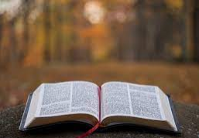
^Gospel
Reading
Luke 12: 42-48

Slide 31
And the Lord said, “Who then is the faithful and wise manager, whom his master will set over his household, to give them their portion of food at the proper time?

Slide 32
Blessed is that servant
whom his master will find
so doing when he comes.
Truly, I say to you, he will set
him over all his possessions

Slide 33
But if that servant says to himself, ‘My master is delayed in coming,’ and begins to beat the male and female servants, and to eat and drink and get drunk, . . .

Slide 34
…the master of that servant will come on a day when he does not expect him & at an hour he does not know, and will cut him in pieces and put him with the unfaithful.

Slide 35
And that servant who knew his master's will
but did not get ready or act according to his will,
will receive a
severe beating.

Slide 36
But the one who
did not know, and
did what deserved a beating,
will receive a light beating.

Slide 37
Everyone to whom
much was given,
of him much will be required, and from him to whom
they entrusted much,
they will demand the more.

Slide 38
L: This is the word of God
for the people of God.
P: Thanks be to God.

Slide 39
#1 in A series on
#1 in A series on
STEWARDSHIP
What is
‘Stewardship’?

Slide 40
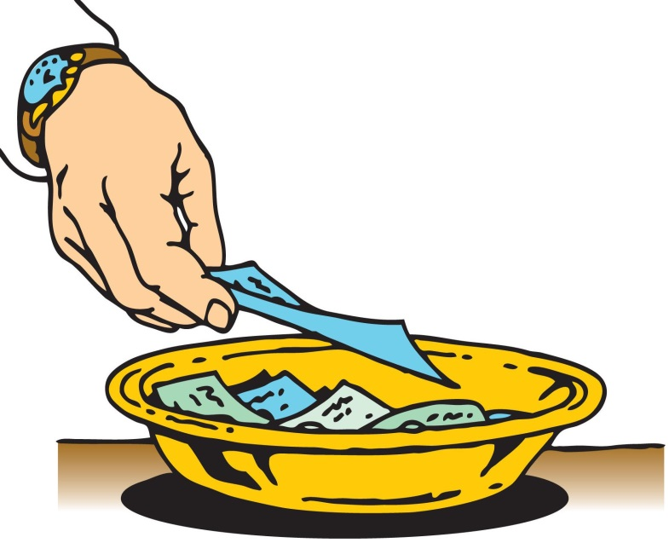
Stewardship
As the music plays, please bring your
TITHES & GIFTS to one of the
collection plates at the front
or rear of the sanctuary.

Slide 41
Offertory
Tom Luther

Slide 42
^Please Stand
The
Doxology

Slide 43
Praise God,
from whom
all blessings flow;

Slide 44
Praise God,
all creatures
here below;

Slide 45
Alleluia!
Alleluia!

Slide 46
Praise God,
the source of
all our gifts!

Slide 47
Praise Jesus Christ,
whose power uplifts!

Slide 48
Praise the Spirit,
Holy Spirit

Slide 49
Alleluia!
Alleluia!
Alleluia!

Slide 50
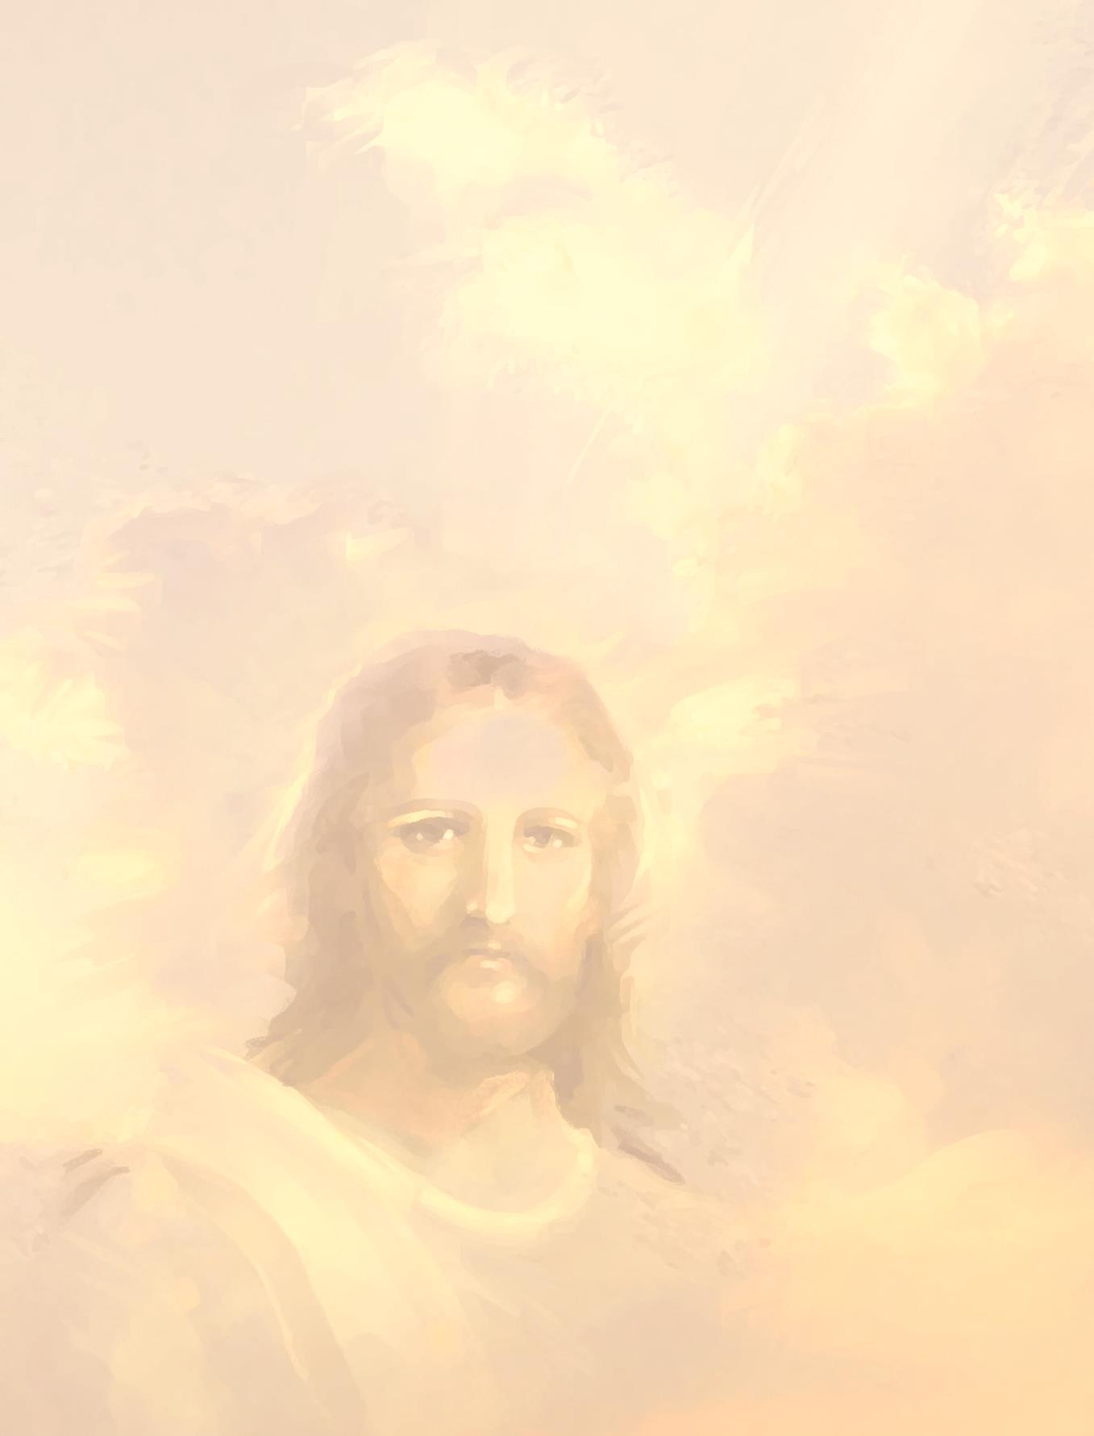
Please be seated.

Slide 51
SHARING JOYS
CONCERNS
and
Pastoral Prayer

Slide 52
in unison:
Our Father,
who art in heaven,
hallowed be thy name.

Slide 53
Thy kingdom come,
thy will be done
on earth
as it is in heaven.

Slide 54
Give us this day
our daily bread.

Slide 55
And forgive us our trespasses,
as we forgive those who trespass
against us.

Slide 56
And lead us
not into temptation,
but deliver us
from evil.

Slide 57
For thine
is the kingdom,
and the power,
and the glory forever. Amen.

Slide 58
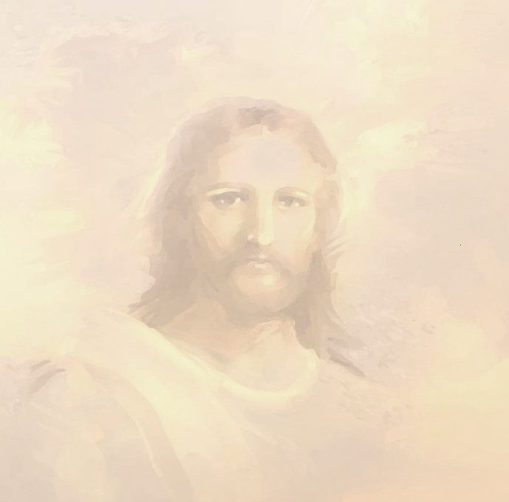
Hymn #398 (v.1,3&5)
“Jesus
Calls Us”
“Jesus
Calls Us”

Slide 59
Jesus calls us o’er the tumult
of our life’s wild, restless sea;
Day by day his
sweet voice soundeth,
saying, “Christian, follow me!”
1.

Slide 60
Jesus calls us from the worship
of the vain world’s golden store,
from each idol
that would keep us,
saying,‘Christian, love me more!’
3.

Slide 61
Jesus calls us! By thy mercies,
Savior, may we hear thy call.
Give our hearts to
thine obedience,
serve & love thee best of all.
5.

Slide 63
Postlude
Organist:
Tom Luther

Slide 65
Postlude
Organist:
Tom Luther

Slide 67
Postlude
Organist:
Tom Luther

Slide 69
Postlude
Organist:
Tom Luther

Slide 70
!

