Slide 1


Pastor Jim Schrimplin

Slide 2


Slide 3

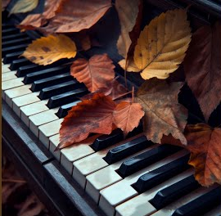
Prelude
My Lord,
What a Mornin’

Slide 4

Call to Worship
(responsive)

Slide 5

Liturgist:
Jesus is in our midst.
Jesus, our healer, deliverer, and friend is here

Slide 6
People:
We have heard so many good things about him,
but we long to meet him,
to encounter him ourselves.

Slide 7
Liturgist:
Call out to him,
and do not be silent.
Like Bartimaeus,
shout to him . . .

Slide 8
… & do not allow anyone to silence your voice.
Cry out and tell Jesus what you need!

Slide 9
People:
Jesus, Son of David,
have mercy on us!
We need a touch from you!

Slide 10
Touch me;
touch us in our need,
which we lift right now
in our hearts!

Slide 11
Liturgist:
In this time of worship, celebrate God’s goodness!

Slide 12
People:
In this time of worship,
we know that Jesus
touches our place of need.
Hallelujah! Amen!

Slide 13
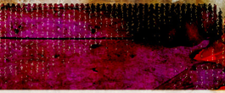
Choir Anthem
“Take It To The
“Take It To The
Lord in Prayer”
Lord in Prayer”

Slide 14

CHILDREN’S
Moment

Slide 15


Slide 16
Dismissal to
Sunday School

Slide 17

Pastor’s
Opening
Prayer

Slide 18



Hymn #128 (vs. 1, 2 & 4)
“He
Leadeth
Me”
“He
Leadeth
Me”

Slide 19
V1
He leadeth me: O blessed thought!
O words with heavenly comfort fraught!
What-e’er I do, where-e’er I be,
still ‘tis God’s hand that leadeth me.

Slide 20
Ref:
He leadeth me, He leadeth me,
by his own hand he leadeth me,
his faithful follower I would be,
for by his hand he leadeth me.

Slide 21
Sometimes mid scenes
of deepest gloom,
sometime where Eden’s bowers bloom,
by waters still, o’er troubled sea,
still ‘tis his hand that leadeth me.
V2

Slide 22
Ref:
He leadeth me, He leadeth me,
by his own hand he leadeth me,
his faithful follower I would be,
for by his hand he leadeth me.

Slide 23

V3
Lord, I would place my hand in thine,
nor ever murmur nor repine;
content, whatever lot I see,
since ‘tis my God that leadeth me.

Slide 24
Ref:
He leadeth me, He leadeth me,
by his own hand he leadeth me,
his faithful follower I would be,
for by his hand he leadeth me.

Slide 25
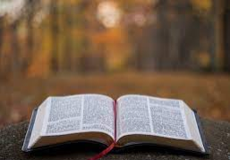
Scripture
Reading
1Thessolonians 5:12-19

Slide 26

We ask you, brothers,
to respect those who
labor among you and
are over you in the Lord
and admonish you, …

Slide 27
…and to esteem them very highly in love
because of their work.
Be at peace among yourselves.

Slide 28
And we urge you, brothers, admonish the idle, encourage the fainthearted, help the weak,
be patient with them all.

Slide 29
See that no one repays anyone evil for evil,
but always seek to do
good to one another
and to everyone.

Slide 30
Rejoice always,
pray without ceasing,
give thanks
in all circumstances;

Slide 31
…for this is the will of God
in Christ Jesus for you.
Do not quench the Spirit.

Slide 32
L: This is the word of God
for the people of God.
P: Thanks be to God.

Slide 33
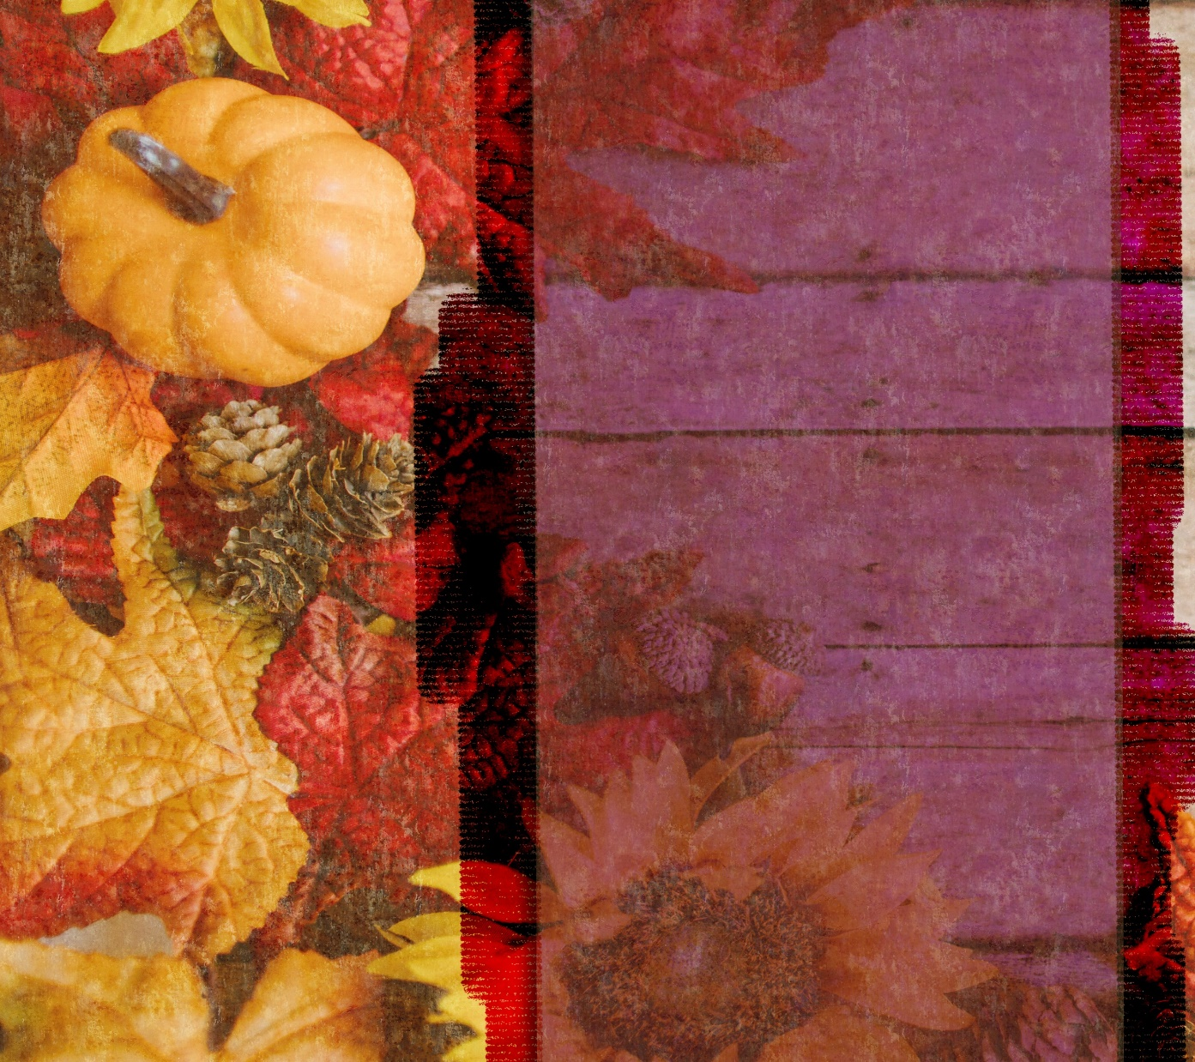



#2 in A series on
#2 in A series on
STEWARDSHIP
Stewardship
PRAYER
of PRAYER

Slide 34
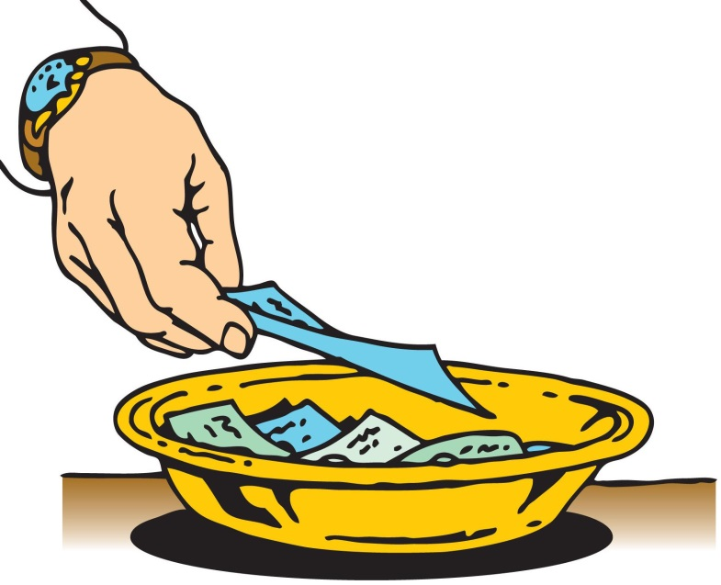
Stewardship
As the music plays, please bring your
TITHES & GIFTS to one of the
collection plates at the front
or rear of the sanctuary.

Slide 35

Offertory
Savior Like a Shepherd Lead Us

Slide 36



^Please Stand
The
Doxology

Slide 37
Praise God,
from whom
all blessings flow;

Slide 38
Praise God,
all creatures
here below;

Slide 39
Alleluia!
Alleluia!

Slide 40
Praise God,
the source of
all our gifts!

Slide 41
Praise Jesus Christ,
whose power uplifts!

Slide 42
Praise the Spirit,
Holy Spirit

Slide 43

Alleluia!
Alleluia!
Alleluia!

Slide 44
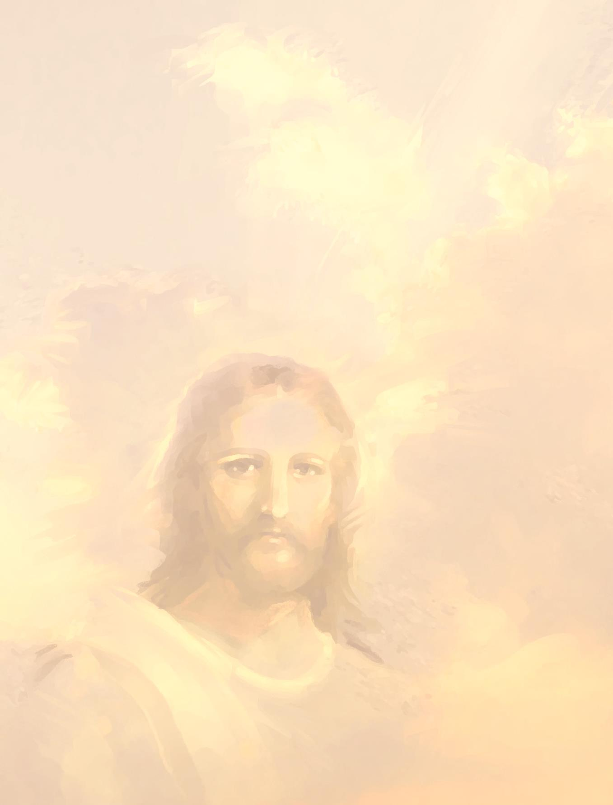

Please be seated.

Slide 45


SHARING JOYS
CONCERNS
and
Pastoral Prayer

Slide 46

in unison:
Our Father,
who art in heaven,
hallowed be thy name.

Slide 47
Thy kingdom come,
thy will be done
on earth
as it is in heaven.

Slide 48
Give us this day
our daily bread.

Slide 49
And forgive us our trespasses,
as we forgive those who trespass
against us.

Slide 50
And lead us
not into temptation,
but deliver us
from evil.

Slide 51
For thine
is the kingdom,
and the power,
and the glory forever. Amen.

Slide 52


Hymn #496 (v.1 & 3)
“Sweet Hour
of Prayer”
“Sweet Hour of Prayer”

Slide 53

Sweet hour of prayer,
sweet hour of prayer!
that calls me from a world of care,
and bids me at my Father’s throne
make all my wants and wishes known.
1.

Slide 54
In seasons of distress and grief,
my soul has often found relief,
and oft escaped the tempter’s snare
by thy return, sweet hour of prayer!

Slide 55
Sweet hour of prayer,
sweet hour of prayer!
thy wings shall my petition bear
to him whose truth and faithfulness
engage thy waiting soul to bless.
3.

Slide 56
And since he bids me seek his face,
believe his word, and trust his grace,
I’ll cast on him my every care
& wait for thee, sweet hour of prayer!

Slide 57


Slide 58
Postlude
Shine, Jesus, Shine

Slide 59


