Slide 1
February 2, 2025
Eldridge United Methodist Church

Slide 2
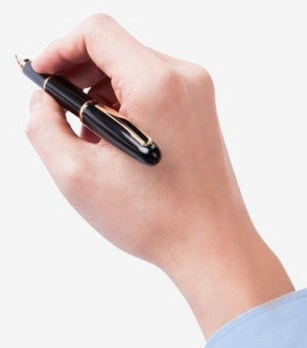
Hello Visitors!
Help us to get to know
you by putting ALL
your contact info on
the attendance sheet.

Slide 3
SERVING TODAY
Hosts: Christie & Doug
Liturgist: Linda Tubbs
Pianist: Kathy Dawson
Communion: Dan & Becky Esbaum
Kitchen: Lori Stackhouse

Slide 4
Today’s VIDEO PRELUDE:
“You Raise Me Up”
performed by BYU Vocal Point

Slide 5
2024 Financial Statement
EUMC Financial Status Info
2025 Stewardship Info
2025 Time & Talent Survey
Pick yours up TODAY
in the Gathering Area

Slide 6
Question$ about your 2024 Pledge?
Trish Reisener is happy to clarify
for you. She will be available
after worship or call the office
for her contact
information.

Slide 7
2025 Flower Chart
is now available for sign-ups, please!

Slide 8
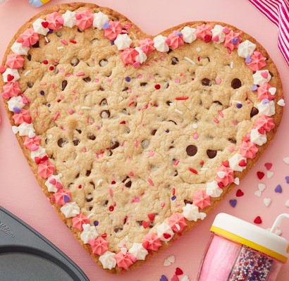
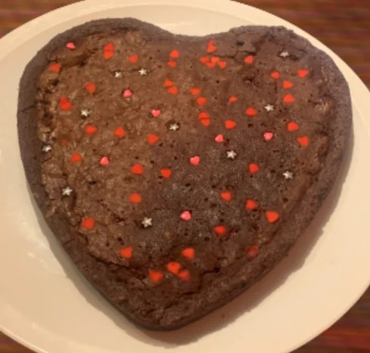
12” Valentine Cookies
Chocolate Chip
Brownie
Last Sunday to order
Only $14 each
Order Sheet on Table in GA

Slide 9
Join us for
TUESDAY
BIBLE STUDY
10 am

Slide 10
YOGA time!
YOGA time!
Come join us
Wednesday mornings
9am in the sanctuary

Slide 11
FEB 9th CREW
Hosts: Daisy & Boise Schoonover
Organist: Tom Luther
Liturgist: Trish Reisener
Screens: CJ Albertson
Kitchen: Betty Frazee

Slide 12
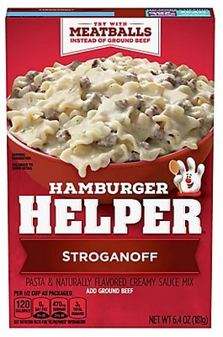
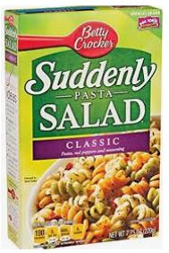
February at the
FOOD PANTRY
*SIDE DISHES
*Soup CRACKERS
*‘Hamburger Helper’

Slide 13
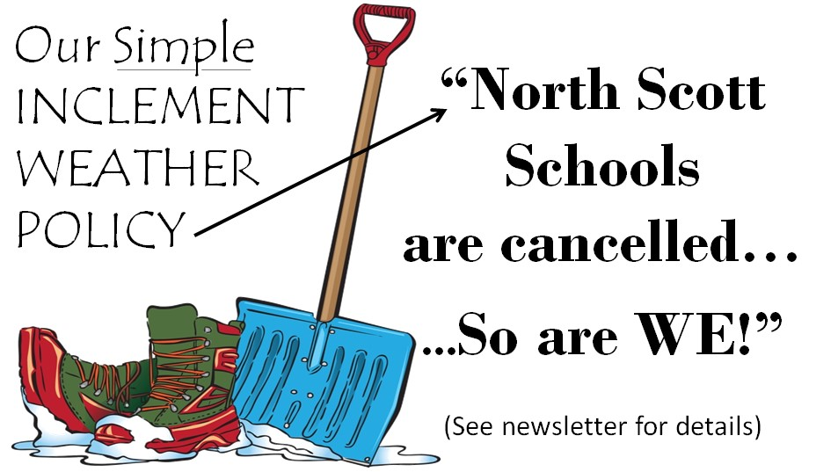

Slide 14
Quilting Bible Study
Begins
Feb. 3
Mondays @ 10am
Women of the Bible

Slide 15
Don’t forget to give the office your
forwarding information!

Slide 17
“The MISSION of the
Eldridge United Methodist Church
is to be a community of loving disciples who proclaim and live love of God and neighbor.”

Slide 18
www.eldridgeumc.org

