Slide 1
Welcome
and
Announcements

Slide 2
Piano
Prelude
Kathy Dawson, pianist

Slide 3
(responsive)
Call to
Worship

Slide 4
L: Children of God, we gather to worship, sing, and proclaim with joy the good works God is doing in our midst.

Slide 5
People: We gather to worship, as is our custom.

Slide 6
L: We also gather today to pray for our families, our community, and our world. To name the challenges that press in around us, …

Slide 7
L: …to lament the suffering in our world, to declare our trust in God in the midst of hardship.

Slide 8
People: We gather to worship, as is our custom.

Slide 9
L: We, like those in Nazareth, gather to hear and receive the Word of God proclaimed among us. To encounter the life-giving message of God’s…

Slide 10
L: … love redeems us to be bearers of love and freedom in this world.

Slide 11
People: We gather to worship, as is our custom.

Slide 12
Hymn #558 v. 1,2,4
“We Are The Church”

Slide 21
We Are the Church (Verse 4)
4. And when the people gather, there’s singing and there’s praying, there’s laughing and there’s crying sometimes, all of it saying:

Slide 24
CHILDREN’S MOMENT
with Pastor Jim

Slide 25
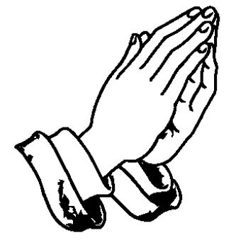
Opening
Prayer

Slide 40
L: This is the word of God
for the people of God.
P: Thanks be to God.

Slide 41
#4 in Pastor’s New Year’s Series
Supporting the Mission of the Church

Slide 42
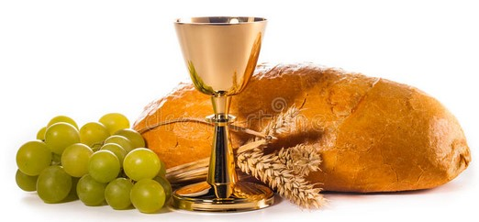
The Sacrament of
Holy Communion

Slide 43
Prayer of
Confession

Slide 44
All:
Merciful God,
We confess that we have not loved you
with our whole heart.

Slide 45
We have failed to be
an obedient church.
We have not done your
will, we have broken
your law . . .

Slide 46
. . .we have rebelled against your love, we have not loved our neighbors . . .

Slide 47
. . . and we have not
heard the cry of
the needy.
Forgive us, we pray.

Slide 48
Free us for
joyful obedience,
through Jesus Christ
our Lord.
Amen

Slide 49
Pardon

Slide 50
Pastor:
Hear the good news:
Christ died for us while
we were yet sinners;

Slide 51
That proves God’s love
toward us.
In the name of
Jesus Christ,
you are forgiven!

Slide 52
People:
In the name of
Jesus Christ,
you are forgiven!

Slide 53
Glory to God.
Amen.

Slide 54
The Great
Thanksgiving

Slide 55
Pastor:
The Lord be with you.
People:
And also with you.

Slide 56
Pastor:
Lift up your hearts.
People: We lift them up to the Lord.

Slide 57
Pastor : Let us give thanks to the Lord our God.
People: It is right to give our thanks & praise.

Slide 58
Pastor: It is right, & a good & joyful thing, always and everywhere to give thanks to you, Father Almighty, creator of heaven and earth.

Slide 59
And so with your people on earth and all the company of heaven, we praise your name and join the unending hymn:

Slide 60
People:
Holy, holy, holy Lord,
God of power & might,

Slide 61
heaven & earth are full
of your glory.
Hosanna in the highest.

Slide 62
Blessed is he who comes
in the name of the Lord.
Hosanna in the highest.

Slide 63
(Pastor)
Holy are you and
blessed is your Son,
Jesus Christ.

Slide 64
By the baptism
of his suffering, death,
and resurrection

Slide 65
you gave birth to
your church,
delivered us from
slavery to sin & death,

Slide 66
and made with us
a new covenant
by water
and the Spirit.

Slide 67
(Hymnals closed – Looking at Pastor)
The
Institution

Slide 68
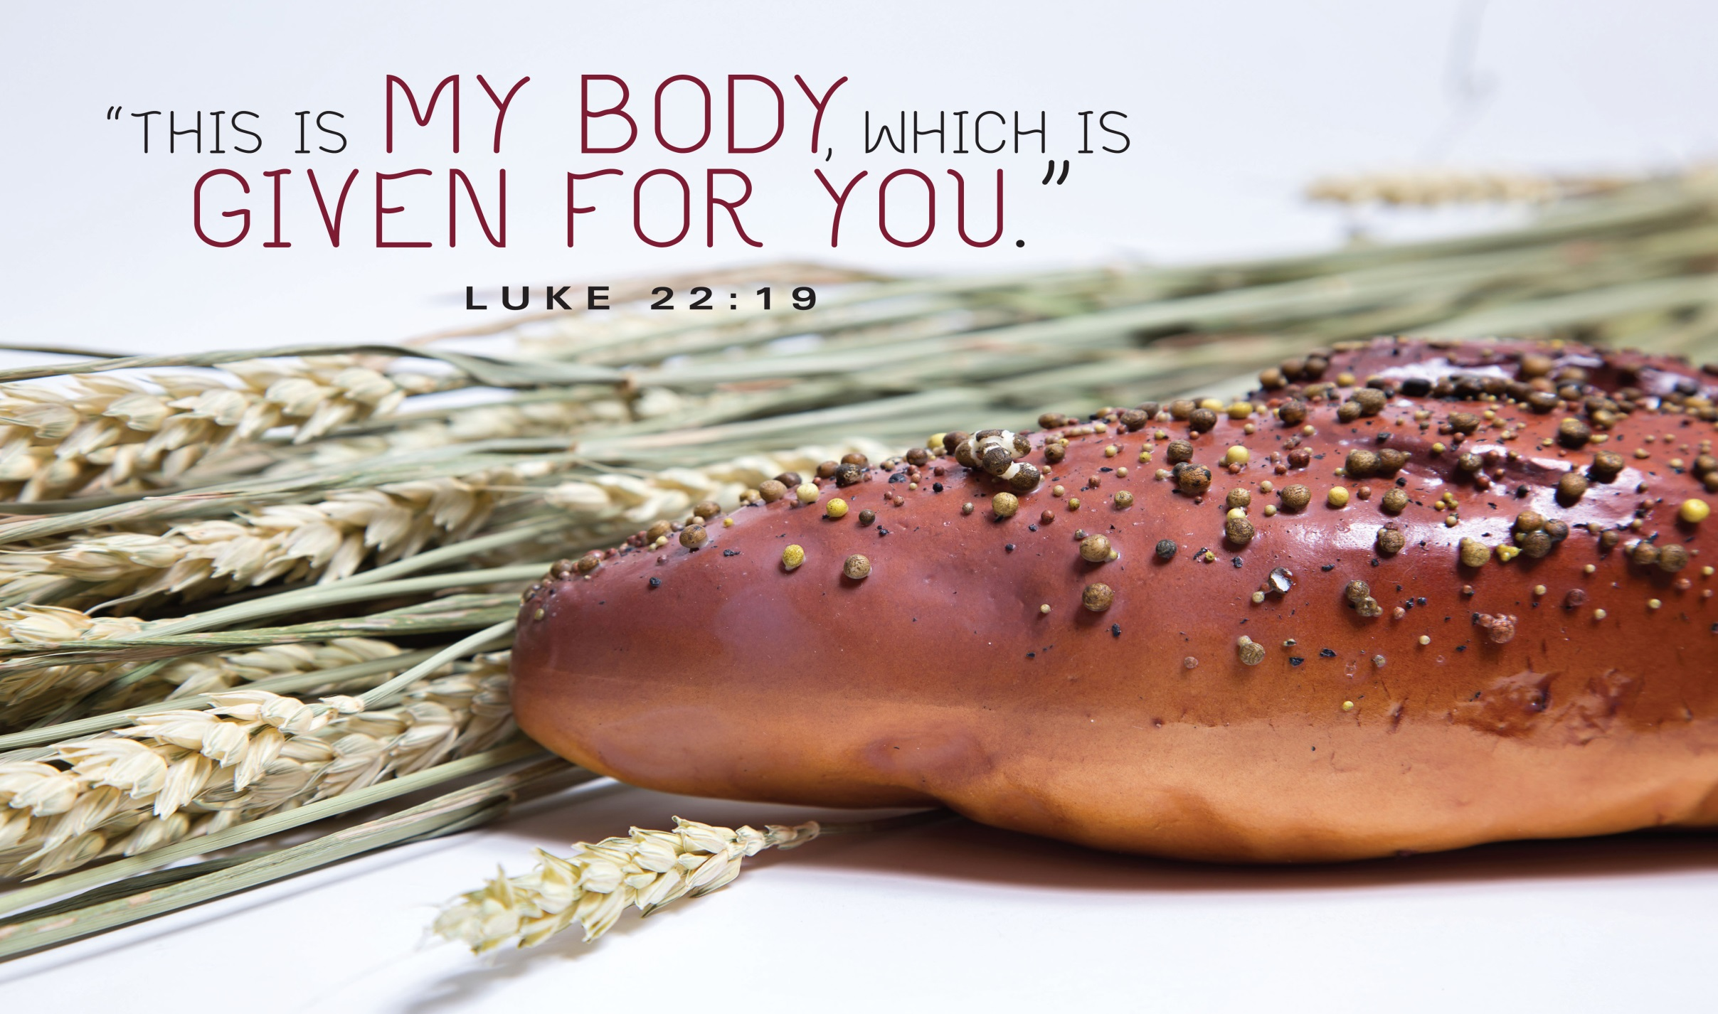
the BODY of CHRIST
given for you

Slide 69
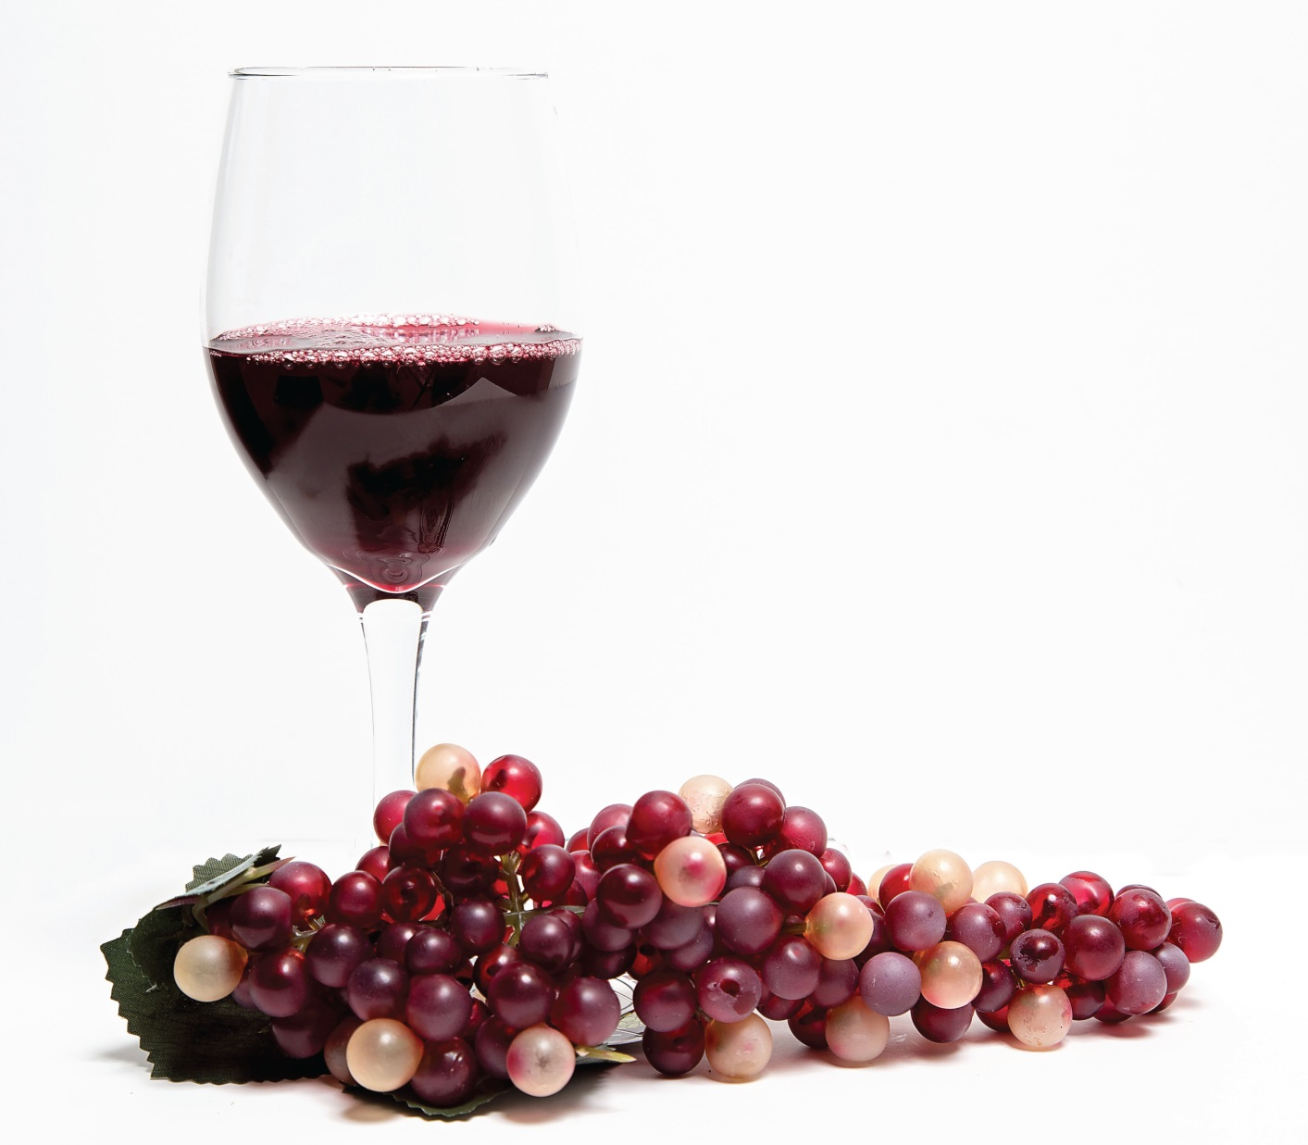
the
BLOOD of CHRIST
given for you

Slide 70
Pastor:
…as we proclaim the
mystery of faith.

Slide 71
People:
Christ has died.
Christ is risen.
Christ will come again.

Slide 72
. . . Through your son
Jesus Christ,
with the Holy Spirit
in your holy Church,
(Pastor continues…)

Slide 73
all honor and glory is yours, almighty God,
now and forever.
People: AMEN

Slide 74
The Bread
& The Cup

Slide 75
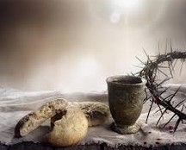
Come.
Receive the bread.
Drink of the cup.
Remember.

Slide 76
Unison Prayer
Eternal God,
we give you thanks for
this holy mystery
in which you have given
yourself to us.

Slide 77
Grant that we may
go into the world
in the strength
of your Spirit,
to give ourselves for others.

Slide 78
In the name of
Jesus Christ
our Lord.
AMEN

Slide 79
Offertory
As the music plays, please
bring your TITHES & GIFTS to one of the collection plates at the front or rear of the sanctuary.

Slide 80
*Please Stand
The
Doxology

Slide 81
Praise God,
from whom
all blessings flow;

Slide 82
Praise God,
all creatures
here below;

Slide 83
Alleluia!
Alleluia!

Slide 84
Praise God,
the source of
all our gifts!

Slide 85
Praise
Jesus Christ, whose power uplifts!

Slide 86
Praise the Spirit,
Holy Spirit!
Alleluia! Alleluia!

Slide 87
Alleluia!

Slide 88
SHARING JOYS
& CONCERNS

Slide 89
Pastoral
Prayer

Slide 90
in unison:
Our Father,
who art in heaven,
hallowed be thy name.

Slide 91
Thy kingdom come,
thy will be done
on earth
as it is in heaven.

Slide 92
Give us this day
our daily bread.

Slide 93
And forgive us our trespasses,
as we forgive those
who trespass against us.

Slide 94
And lead us
not into temptation,
but deliver us
from evil.

Slide 95
For thine
is the kingdom,
and the power,
and the glory forever. Amen.

Slide 96
Hymn #170 v. 1 & 3
“O How I Love Jesus”

Slide 101
Dismissal
with
Blessing

Slide 102
Postlude
Kathy Dawson, pianist

