Slide 3
3
rd
week

Slide 4
“The MISSION of the
Eldridge United Methodist Church
is to be a community of loving disciples who proclaim and live love of God and neighbor.”

Slide 5
THIRD SUNDAY in Lent
THIRD SUNDAY in Lent

Slide 6
Prelude
Prelude
Linda Reickard, piano

Slide 7
Call
to
Worship
Call
to
Worship

Slide 8
Liturgist:
Children of God,
what has God
done for you?

Slide 9
PEOPLE:
God saves,
provides, and
holds us in
His steadfast love.

Slide 10
Liturgist:
Consider & remember:
in the joyful times and
in the sorrowful times,
what has God done
for you?

Slide 11
PEOPLE:
God covers us and
lifts us up, protecting
& empowering us
with steadfast love.

Slide 12
Liturgist:
When you have been
like the fig tree in Jesus’ story that seems unable
to produce . . .

Slide 13
…and that everyone
has given up on,
what has God done
for you?

Slide 14
PEOPLE:
God tends the soil & waters the ground, nurturing us into life with steadfast love.

Slide 15
Liturgist:
Children of God,
come let us worship God who never gives up on us!

Slide 16
PEOPLE:
We come to worship
and cling to God,
for God’s steadfast love never fails!

Slide 17
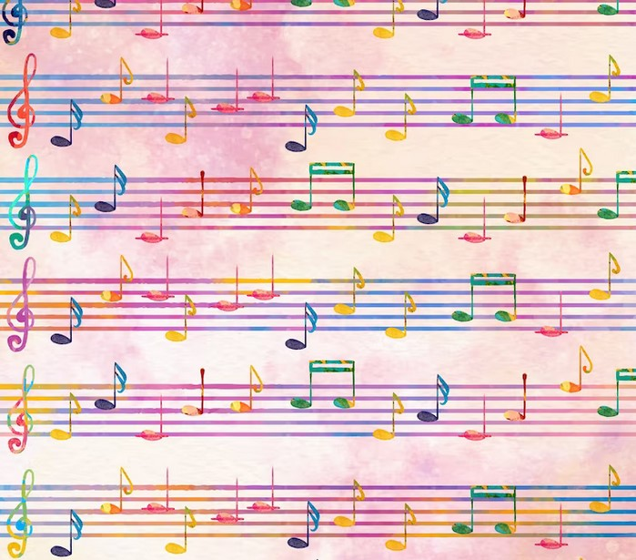
HYMN #496
Sweet Hour
of Prayer
”Sweet Hour
of Prayer“

Slide 18
1
Sweet hour of prayer!
Sweet hour of prayer!
that calls me from a world of care,
and bids me at my Father’s throne
make all my wants and wishes known.

Slide 19
In seasons of distress and grief;
my soul has often found relief,
and oft escaped the tempter’s snare,
by thy return, sweet hour of prayer!

Slide 20
2
Sweet hour of prayer!
Sweet hour of prayer!
the joys I feel, the bliss I share
of those whose anxious spirits burn
with strong desires for thy return!

Slide 21
With such I hasten to the place
where God, my Savior shows his face,
and gladly take my station there,
and wait for thee, sweet hour of prayer

Slide 22
3
Sweet hour of prayer!
Sweet hour of prayer!
thy wings shall my petition bear
to him whose truth and faithfulness
engage the waiting soul to bless.

Slide 23
And since he bids me seek his face,
believe his word and trust his grace,
I’ll cast on him my every care,
and wait for thee, sweet hour of prayer.

Slide 24
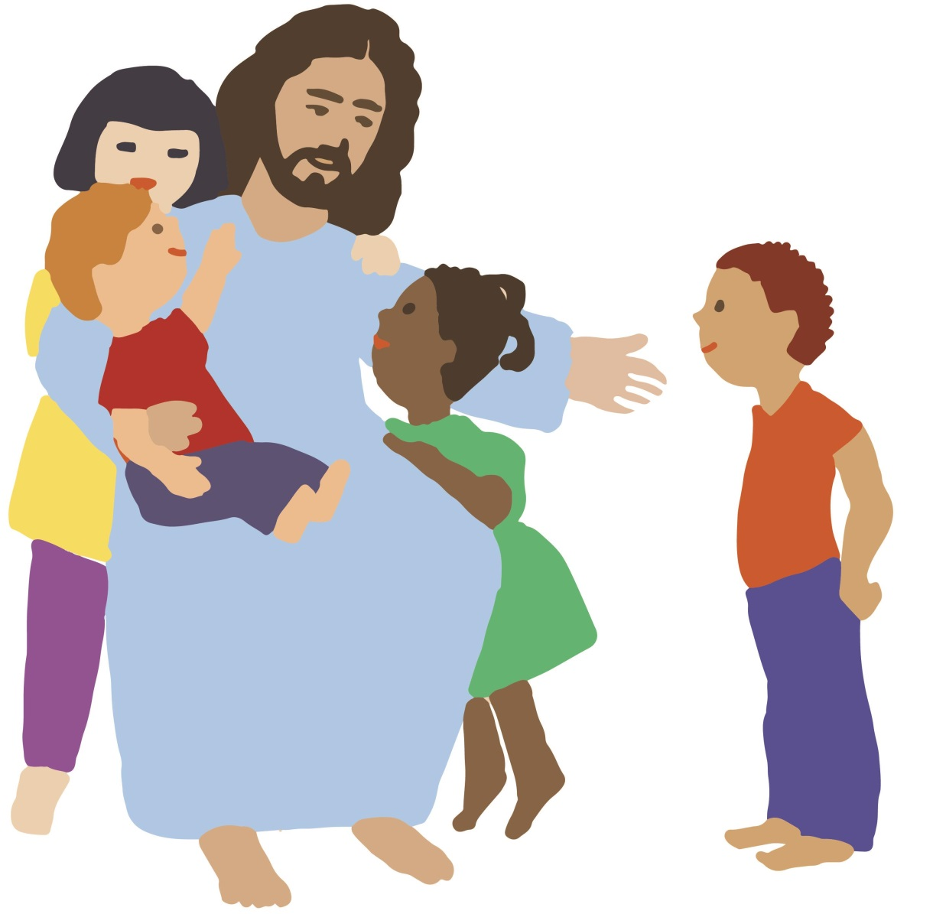
CHILDREN’S
MOMENT
with
Pastor Jim

Slide 25
Opening
Prayer

Slide 26
Choir Anthem:
“Thy Will
Be Done”

Slide 27
Scripture
Reading
1 Samuel 3: 1-9

Slide 28
Now the boy Samuel
was ministering to the Lord
in the presence of Eli.
And the word of the Lord
was rare in those days;
there was no frequent vision.

Slide 29
At that time Eli,
whose eyesight had begun
to grow dim so that
he could not see,
was lying down
in his own place.

Slide 30
The lamp of God
had not yet gone out,
and Samuel was lying down
in the temple of the Lord,
where the ark of God was.

Slide 31
Then the Lord called Samuel,
and he said, “Here I am!”
and ran to Eli and said,
“Here I am, for you called me.”
But he said,
“I did not call; lie down again.”
So he went and lay down.

Slide 32
And the Lord called again, “Samuel!” and Samuel arose and went to Eli and said,
“Here I am, for you called me.” But he said, “I did not call,
my son; lie down again.”

Slide 33
Now Samuel did not yet
know the Lord,
and the word of the Lord
had not yet
been revealed to him.

Slide 34
And the Lord called Samuel again the third time. And he arose and went to Eli & said, “Here I am, for you called me.” Then Eli perceived that the Lord was calling the boy.

Slide 35
Therefore Eli said to Samuel, “Go, lie down, and if he calls you, you shall say, ‘Speak, Lord, for your servant hears.’”
So Samuel went and
lay down in his place.

Slide 36
#3 in Pastor’s
“Means of Grace”
Sermon Series:

Slide 37
C
O
M
M
U
N
I
O
N
The Means of Grace:
Prayer
Scripture
Prayer
fasting
Fellowship

Slide 38
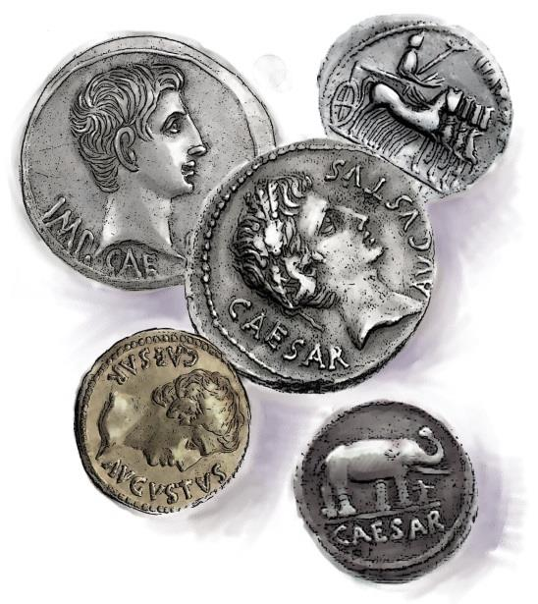
Offertory

Slide 39
the
Doxology

Slide 40
Praise God, from whom all blessings flow.

Slide 41
Praise God, all creatures here below.

Slide 42
Alleluia. Alleluia.

Slide 43
Praise God, the source of all our gifts.

Slide 44
Praise Jesus Christ, whose power uplifts!

Slide 45
Praise the Spirit,
Holy Spirt!

Slide 46
Alleluia. Alleluia.

Slide 47
Alleluia.

Slide 48
SHARING JOYS
& CONCERNS
People’s Prayer

Slide 49
in unison:
Our Father,
who art in heaven,
hallowed be thy name.

Slide 50
Thy kingdom come,
thy will be done
on earth
as it is in heaven.

Slide 51
Give us this day
our daily bread

Slide 52
and forgive us our trespasses,
as we forgive those who trespass against us.

Slide 53
And lead us
not into temptation,
but deliver us
from evil.

Slide 54
For thine
is the KINGDOM,
and the POWER,
and the GLORY forever.
Amen.

Slide 55
HYMN #593 (vs. 2&3)
Sweet Hour
of Prayer
”Here I Am,
Lord“

Slide 56
I, the Lord of snow and rain,
I have borne my people’s pain.
I have wept for love of them.
They turn away.
2

Slide 57
I will break their hearts of stone,
Give them hearts for love alone.
I will speak my word to them.
Whom shall I send?
2

Slide 58
refrain:
Here I am, Lord. Is it I, Lord?
I have heard you
calling in the night.
I will go, Lord, if you lead me.
I will hold your people in my

Slide 59
I, the Lord of wind and flame,
I will tend the poor and lame,
I will set a feast for them.
My hand will save.
3

Slide 60
Finest bread I will provide
till their hearts be satisfied.
I will give my life to them.
Whom shall I send?
3

Slide 61
refrain:
Here I am, Lord. Is it I, Lord?
I have heard you
calling in the night.
I will go, Lord, if you lead me.
I will hold your people in my

Slide 62
Blessing
&
Dismissal

Slide 63
Postlude
Postlude
Linda Reickard, piano

Slide 64
Have a
Blessed
week!
Have a
week!
Blessed

